Slide 1

We’ll be starting shortly!
To help us run the workshop smoothly, please kindly:
Submit all questions using the Q&A function
If you have an urgent request, please use the “Raise Hand” function
Thank you!

Slide 2
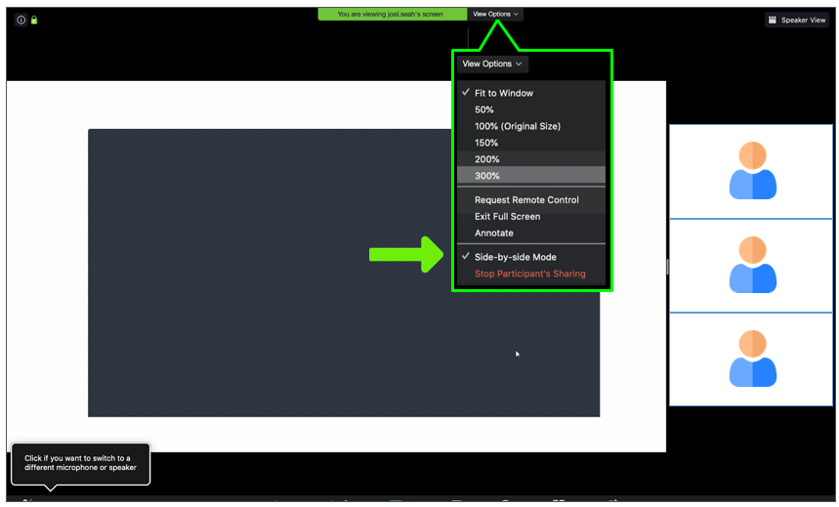
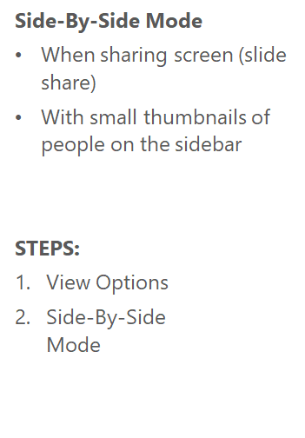
Using Zoom: People & Slides

Slide 3
The Science of Emotions:
Introduction to Sentiment Analysis
Computers have feelings, too.
Notes:
Hello guys, good afternoon. Thanks for joining me in this workshop.
And as announced, i will be presenting this webinar mostly in bahasa indonesia.

Slide 4
Who am I
Hello! My name is Raka.
Learning Architect at Hacktiv8 Jakarta.
I make 50+ Online Courses at kode.id and directed 3 Hybrid Courses at Hacktiv8.
Notes:
Panelist Introduction

Slide 5
HACKTIV8
Hacktiv8 Prepares Professionals for high-growth careers in the Digital Economy.
We create skills-based training programs which is designed to meet the needs of employers.
By combining technical skills and the growth mindset, we deliver a holistic learning experience for professionals to succeed in their careers.
Notes:
Hacktiv8 in a nutshell
Perkembangan teknologi yang sangat pesat menyebabkan peningkatan permintaan programmer oleh perusahan-perusahan di indonesia, tapi sumber daya manusia yang tersedia masi sedikit dan sebagian besar dari mereka adalah lulusan IT ataupun sistem informasi yang belum memiliki skill coding yang mempuni, maka karena itu Hacktiv8 hadir untuk melatih teman-teman yang memiliki background IT ataupun non IT untuk bisa menjadi seorang programer, selain bertujuan memajukan indonesia dalam bidang teknologi kita juga bertujuan untuk membantu taraf hidup masyarakat indonesia jadi lebih baik dengan menghasilkan lulusan yang berkualitas. indonesia memiliki kebutuhan programming

Slide 6


Student Experience and Career Success
#1 in Jakarta, Indonesia
As Rated By Students
Leading the Way to
Outcomes Transparency in Asia
Rated: 4.89 / 5.00
★★★★★
By combining technical skills and the growth mindset, we deliver a holistic learning experience for professionals to succeed in their careers.
Hacktiv8 is the first member of CIRR in Asia to report student outcomes transparently.
Notes:
Ini adalah nilai yang diperoleh hacktiv8, jadi menurut course report
Course report adalah daftar coding bootcamp di seluruh dunia, dan menurut cours report 4,89 dari 5.dan menurut cours report hacktiv8 adalah coding bootcamp no 1 di jakarta.
Kemudian dalam memenuhi komitmen transparansi, hacktiv8 bekerja sama dengan CIR
Cir adalah organisasi nirlaba internasional yang melakukan audit atau pengecekan terhadap keakuratan dan keaslian hasil belajar yang dikeluarkan oleh coding bootcamp di dunia. Cir inilah yang memvalidasi ke akuratan dan keaslian data tersebut. Tanpa persetujuan dari cir, kita tidak boleh menunjukan hasil belajar dari murid kita, data yang teman” lihat sudah dapat aproval dari cir. Sebelum kami tampilkan ke web kami harus di validasi oleh cir ini, agar memastikan bahwa data-data ini akurat

Slide 7
More Information
www.hacktiv8.com
halo@hacktiv8.com
Facebook: Hacktiv8 Indonesia
Instagram & Twitter: Hacktiv8id
+62 21 5099 6662

Slide 8
Session Coverage
NLP and Sentiment Analysis Basic
NLP and Sentiment Analysis Introduction
Types of Sentiment Analysis
How Does Sentiment Analysis Works?
Sentiment Analysis Algorithm
Naive Bayes for Sentiment Analysis
Comparing to Other Model
What’s Next?

Slide 9
Words.
Computers.
Great at working with structured data, like spreadsheets and database tables. But us, humans; usually communicate in words, not in tables. That’s unfortunate for computers.
Notes:
According to industry estimates, only 21% of the available data is present in structured form. Data is being generated as we speak, as we tweet, as we send messages on Whatsapp and in various other activities. Majority of this data exists in the textual form, which is highly unstructured in nature.
Few notorious examples include – tweets / posts on social media, user to user chat conversations, news, blogs and articles, product or services reviews and patient records in the healthcare sector. A few more recent ones includes chatbots and other voice driven bots.
Despite having high dimension data, the information present in it is not directly accessible unless it is processed (read and understood) manually or analyzed by an automated system.

Slide 10
Code will only compile and run if it’s 100 percent free of spelling and syntactic errors.
Notes:
Of course, this is quite different from human languages – what are called natural languages – containing large, diverse vocabularies, words with several different meanings, speakers with different accents, and all sorts of interesting word play.
People also make linguistic faux pas when writing and speaking, like slurring words together, leaving out key details so things are ambiguous, and mispronouncing things. But, for the most part, humans can roll right through these challenges.

Slide 11
The skillful use of language is major part of what makes us, human.
Notes:
Based on information given above, lot of information in the world is unstructured — raw text in English (or bahasa) or another human language. How can we get a computer to understand unstructured text and extract data from it? **Can Computers Understand Language?**
This led to the creation of Natural Language Processing, or NLP

Slide 12
Computer, Communicate.
Natural Language Processing, or NLP, is the sub-field of AI that is focused on enabling computers to understand and process human languages.
Notes:
Natural Language: English language, Bahasa Indonesia, Python Language
Processing: How computer carries out instructions
NLP: enabling computers to understand and process human languages.
How to deal with text data.
With NLP, it is possible to perform certain tasks like Automated Speech and Automated Text Writing in less time. Due to the evolving of large data (text), why not to use the computers which have high computing power, capable of working all day and ability to run several algorithms to perform tasks in no time.
NLP can be divided into 3 categories (Rule-based systems, Classical Machine Learning models and Deep Learning models).
1. Rule-based systems rely heavily on crafting domain-specific rules (e.g: regular expressions), can be used to solve simple problems such as extracting structured data (e.g: emails) from unstructured data (e.g: web-pages), but due to the complexity of human natural languages, rule-based systems fail to build models that can really reason about language.
2. Classical Machine Learning approaches can be used to solve harder problems which rule-based systems can’t solve very well (e.g: Spam Detection), it rely on a more general approach to understanding language, using hand-crafted features (e.g: sentence length, part of speech tags, occurrence of specific words) then providing those features to a statistical machine learning model (e.g: Naive Bayes), which learns different patterns in the training set and then be able to reason about unseen data (inference).
3. Deep Learning models are the hottest part of NLP research and applications now, they generalize even better than the classical machine learning approaches as they don’t need hand-crafted features because they work as feature extractors in an automatic way, which helped a lot in building end-to-end models (little human-interaction). Aside from the feature engineering part, deep learning algorithms learning capabilities are more powerful than the shallow/classical ML ones, which paved its way to achieving the highest scores on different hard NLP tasks (e.g: Machine Translation).

Slide 13
Humans, Complicated.
The process of reading and understanding English (or Bahasa Indonesia) is very complex — and that’s not even considering that English (or Bahasa Indonesia) doesn’t follow logical and consistent rules.
Notes:
There’s an essentially infinite number of ways to arrange words in a sentence.
We can’t give computers a dictionary of all possible sentences to help them understand what humans are blabbing on about.
So an early and fundamental NLP problem was deconstructing sentences into bite-sized which could be more easily processed.
---
In school, you learned about nine fundamental types of English words: nouns, pronouns, articles, verbs, adjectives, adverbs, prepositions, conjunctions, and interjections.
These are called parts of speech. There are all sorts of subcategories too, like singular vs. plural nouns and superlative vs. comparative adverbs, but we’re not going to get into that.
Knowing a word’s type is definitely useful, but unfortunately, there are a lot words that have multiple meanings
A digital dictionary alone isn’t enough to resolve this ambiguity, so computers also need to know some grammar.
For this, phrase structure rules were developed.
For example, in English there’s a rule that says a sentence can be comprised of a noun phrase followed by a verb phrase.
Noun phrases can be an article, like “the”, followed by a noun or they can be an adjective followed by a noun.
And you can make rules like this for an entire language.
Then, using these rules, it’s fairly easy to construct what’s called a parse tree, which not only tags every word with a likely part of speech, but also reveals how the sentence is constructed.
---
These smaller chunks of data allow computers to more easily access, process and to information.

Slide 14

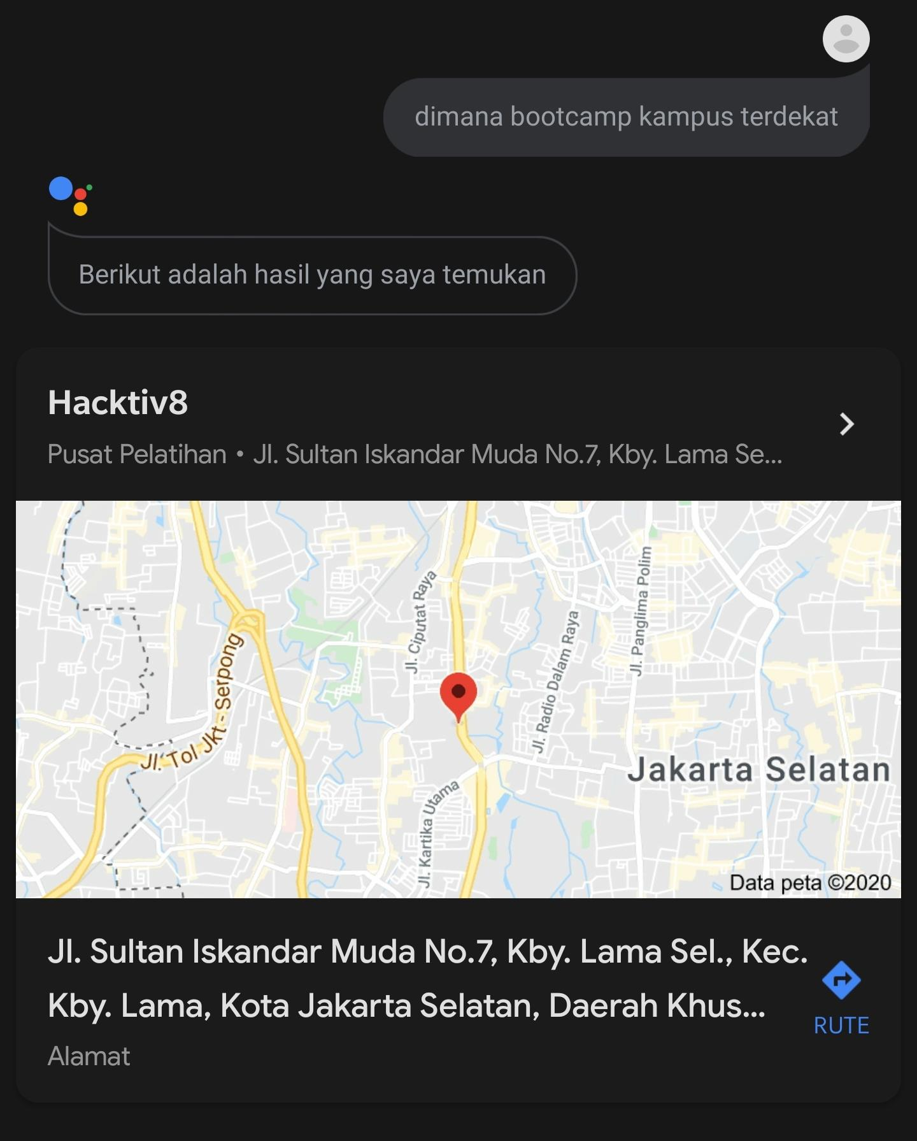
Notes:
Equivalent processes are happening every time you do a voice search, like: “dimana bootcamp campus terdekat?”.
The computer can recognize that this is a “where” question, knows you want the noun “pizza”, and the dimension you care about is “nearest”.
By treating language almost like lego, computers can be quite adept at natural language
Tapi ada tantangan.

Slide 15
"Environmental regulators grill business owner over illegal coal fires."
Notes:
Are the regulators questioning a business owner about burning coal illegally? Or are the regulators literally cooking the business owner? As you can see, parsing English with a computer is going to be complicated.

Slide 16
Language, Complex.
Ambiguity / Crash Blossom, Syntax, Coreference / Anaphora Resolution, Slang, Sarcasm.
Notes:
Ambiguity: it is the challenge when a Single word has different meanings or a sentence that has different meanings in the context and even a sentence refers to sarcasm.
It comprises Ambiguity which is divided into two types: Lexical and Syntactic ambiguity
Lexical Ambiguity is the presence of two or more possible meanings within a single word.
Syntactic Ambiguity is the presence of two or more possible meanings within a single sentence or sequence of words.
Syntax: Think of how a sentence is valid, it based on two things called syntax and semantics where syntax refers to the grammatical rules, on the other hand, semantics is the meaning of the vocabulary symbols within that structure. People change the ordering of sentences it is valid in some cases but not all.
Co-reference: Referring to the same person, thing, country..etc that were mentioned earlier in a sentence or phrase with pronouns.

Slide 17
Demystifying, Language.
Case Folding
Tokenizing
Filtering
Stemming & Lemmatization
Part of Speech
Named Entity Recognition
Chunk / Phrase Extraction
Coreference Resolution
Collocation Extraction
Relationship Extraction
Notes:
Text Processing

Slide 18
Case Folding.
Convert text to lowercase
Remove numbers
Remove punctuation
Remove whitespaces

Slide 19
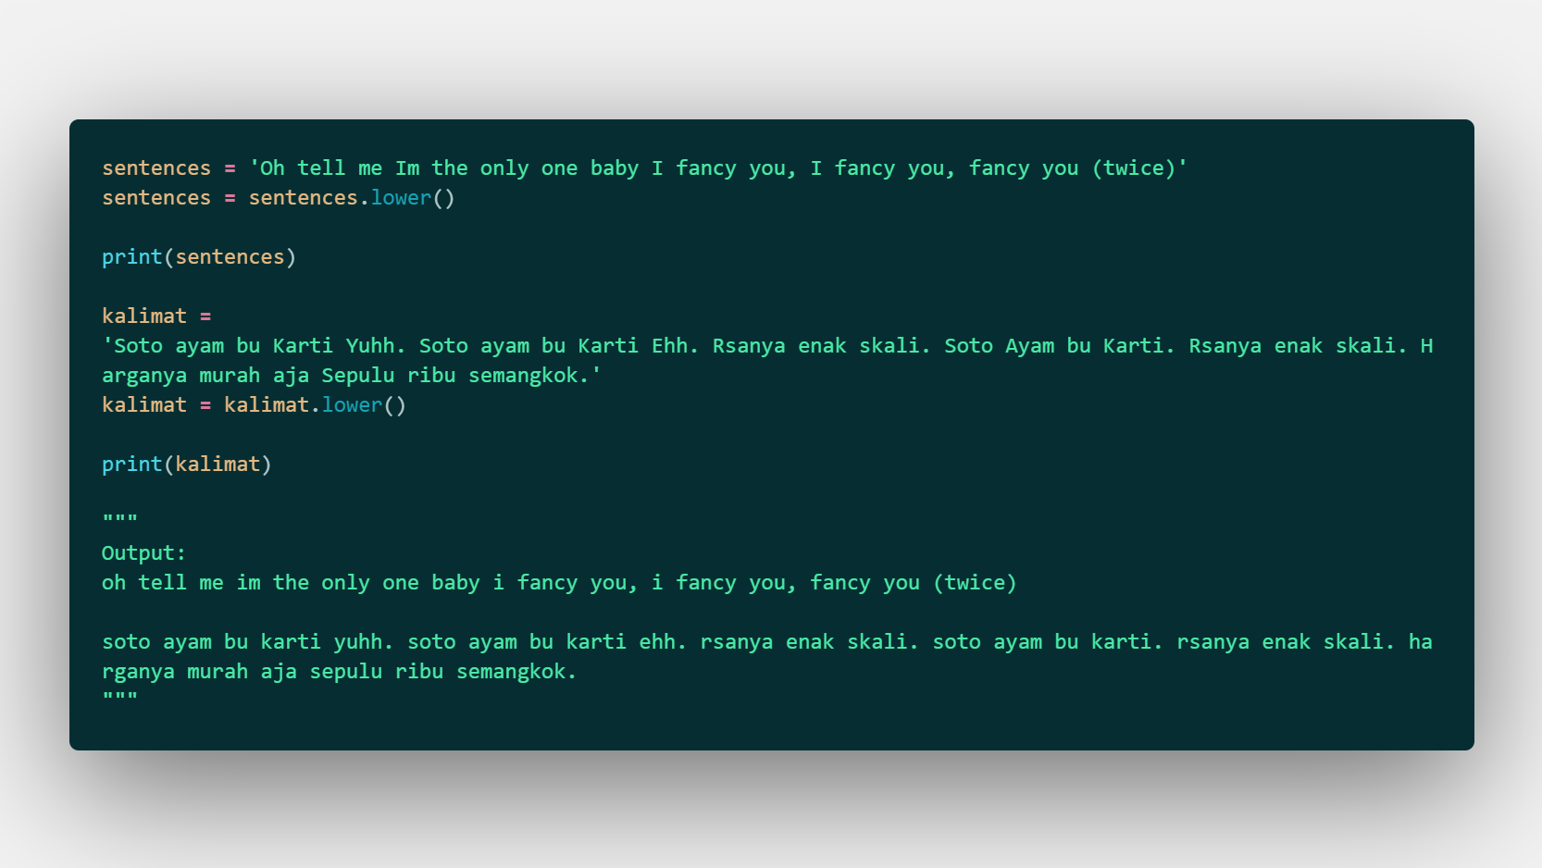

Slide 20
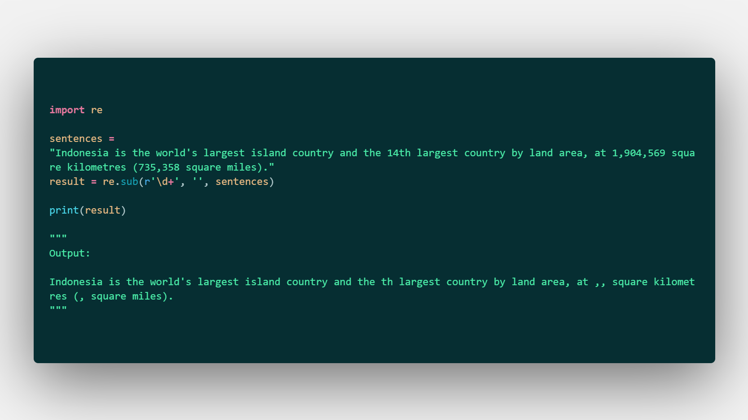

Slide 21
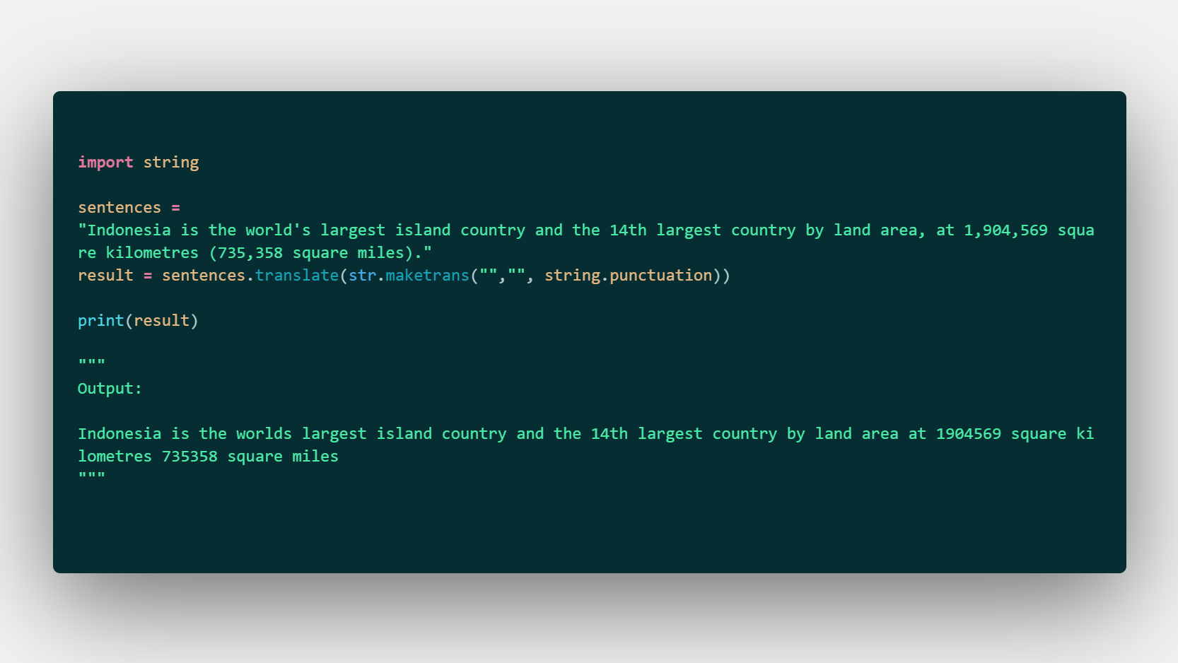

Slide 22
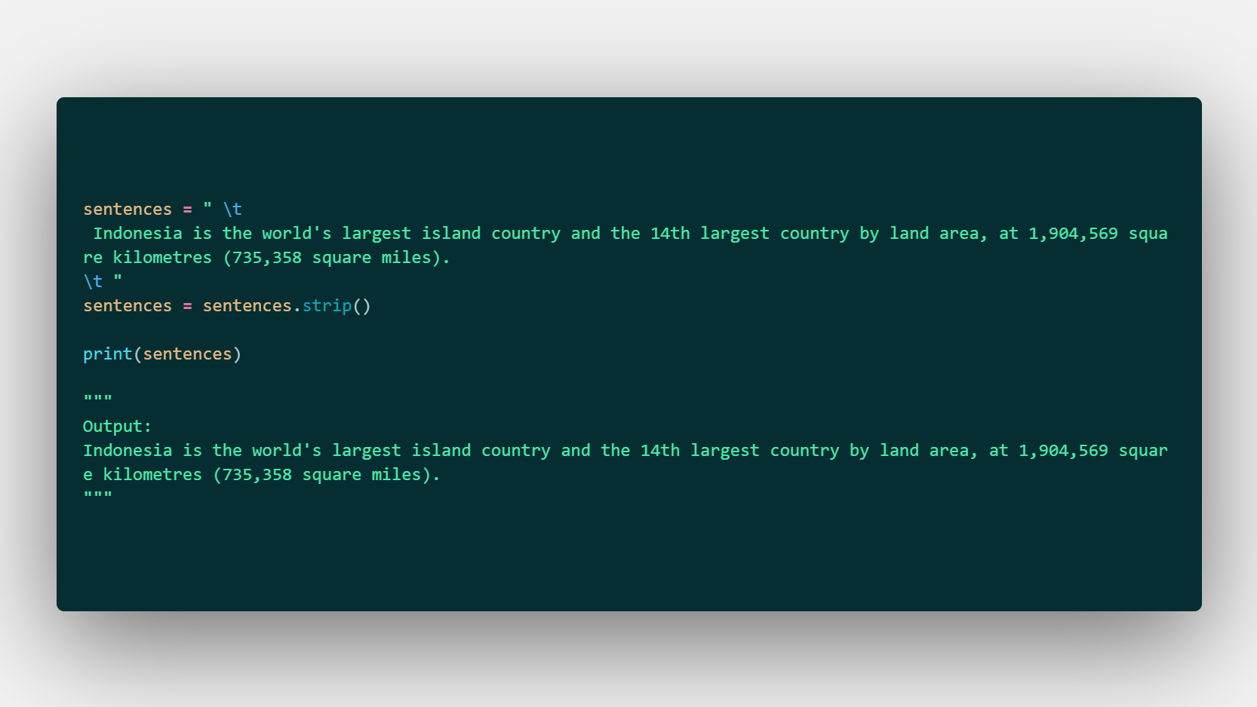

Slide 23
Tokenizing.
Tokenization is the process of splitting the given text into smaller pieces called tokens. Words, numbers, punctuation marks, and others can be considered as tokens.

Slide 24
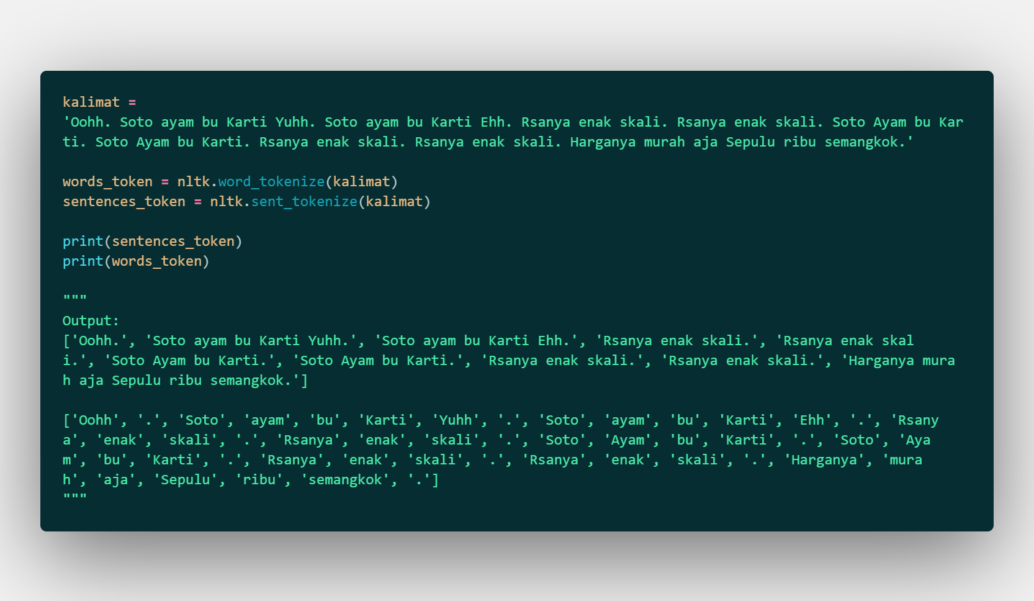

Slide 25
Filtering.
Stop words are the most common words in a language like ‘the’, ‘a’, ‘on’, ‘is’, ‘all’.
These words do not carry important meaning and are usually removed from texts.

Slide 26
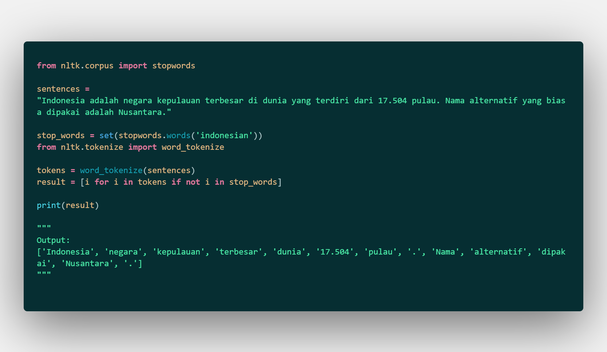

Slide 27
Stemming & Lemmatization.
Stemming is a process of reducing words to their word stem, base or root form (for example, books — book, looked — look).
The aim of lemmatization, like stemming, is to reduce inflectional forms to a common base form. As opposed to stemming, lemmatization does not simply chop off inflections. Instead it uses lexical knowledge bases to get the correct base forms of words.
Notes:
Menendang
Nendang
Tendang

Slide 28
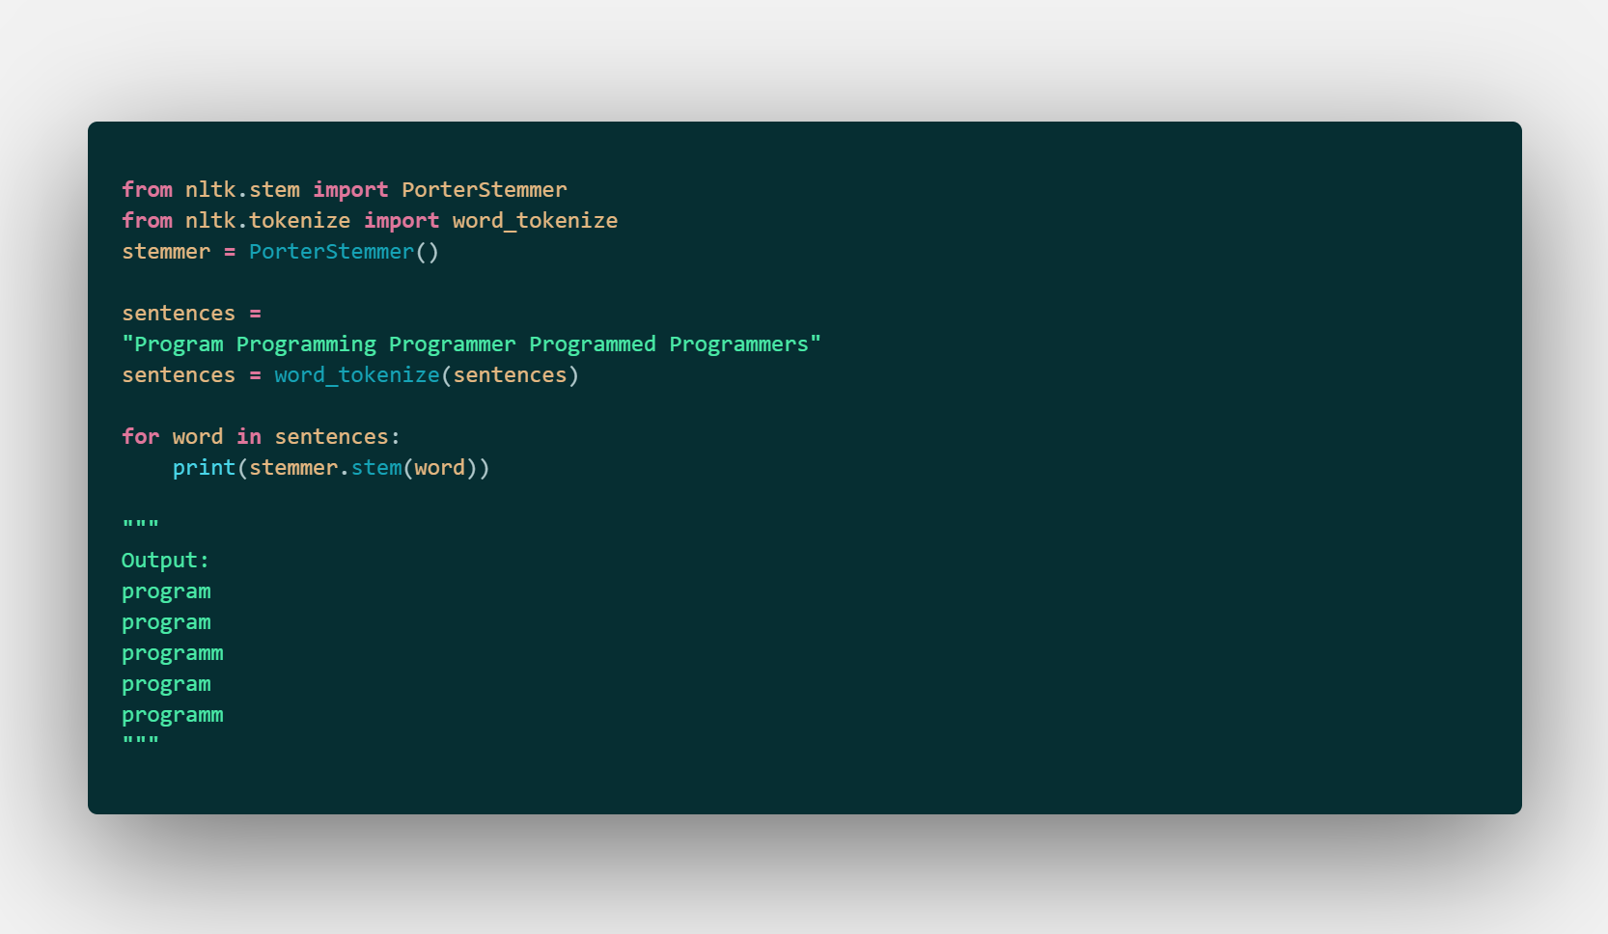

Slide 29
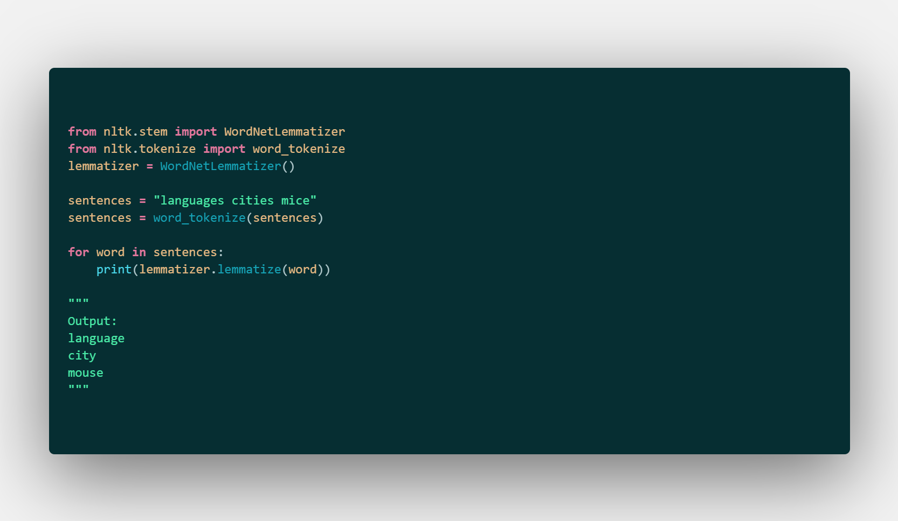

Slide 30
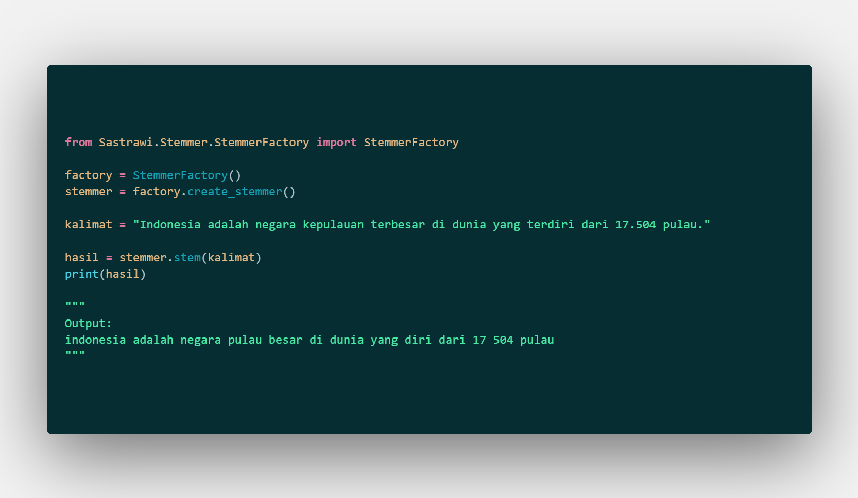

Slide 31
Part of Speech.
Part-of-speech tagging aims to assign parts of speech to each word of a given text (such as nouns, verbs, adjectives, and others) based on its definition and its context.

Slide 32
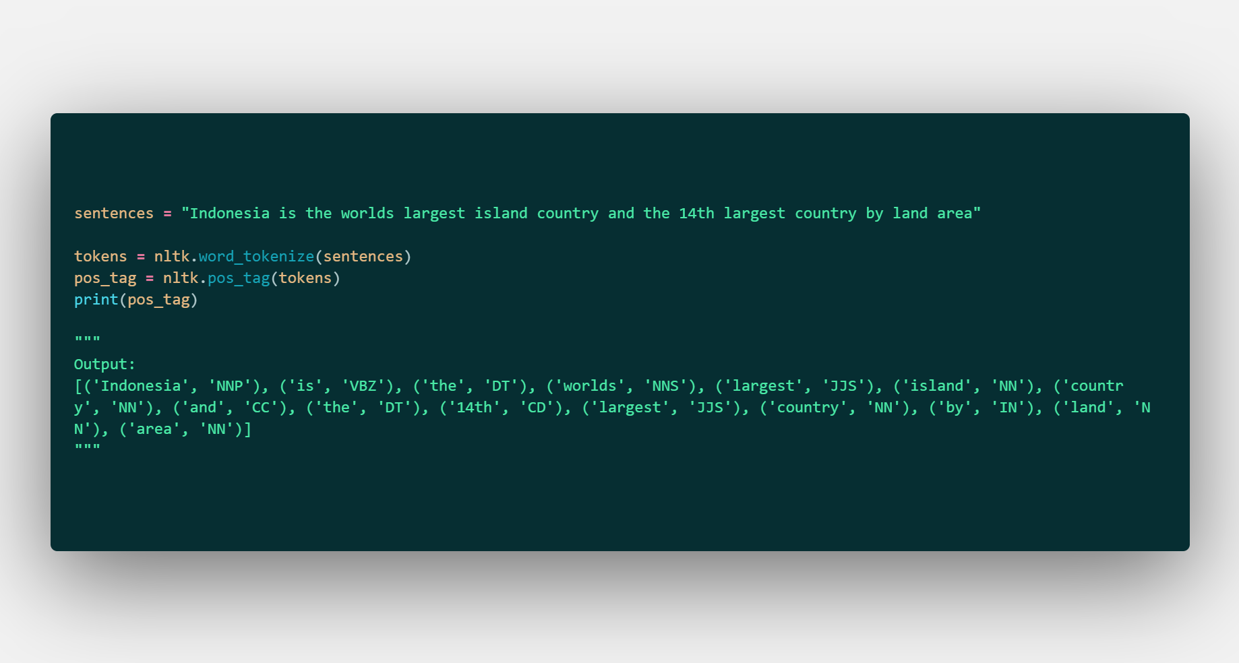

Slide 33
Phrase Extraction.
Chunking is a natural language process that identifies constituent parts of sentences (nouns, verbs, adjectives, etc.) and links them to higher order units that have discrete grammatical meanings (noun groups or phrases, verb groups, etc.)

Slide 34
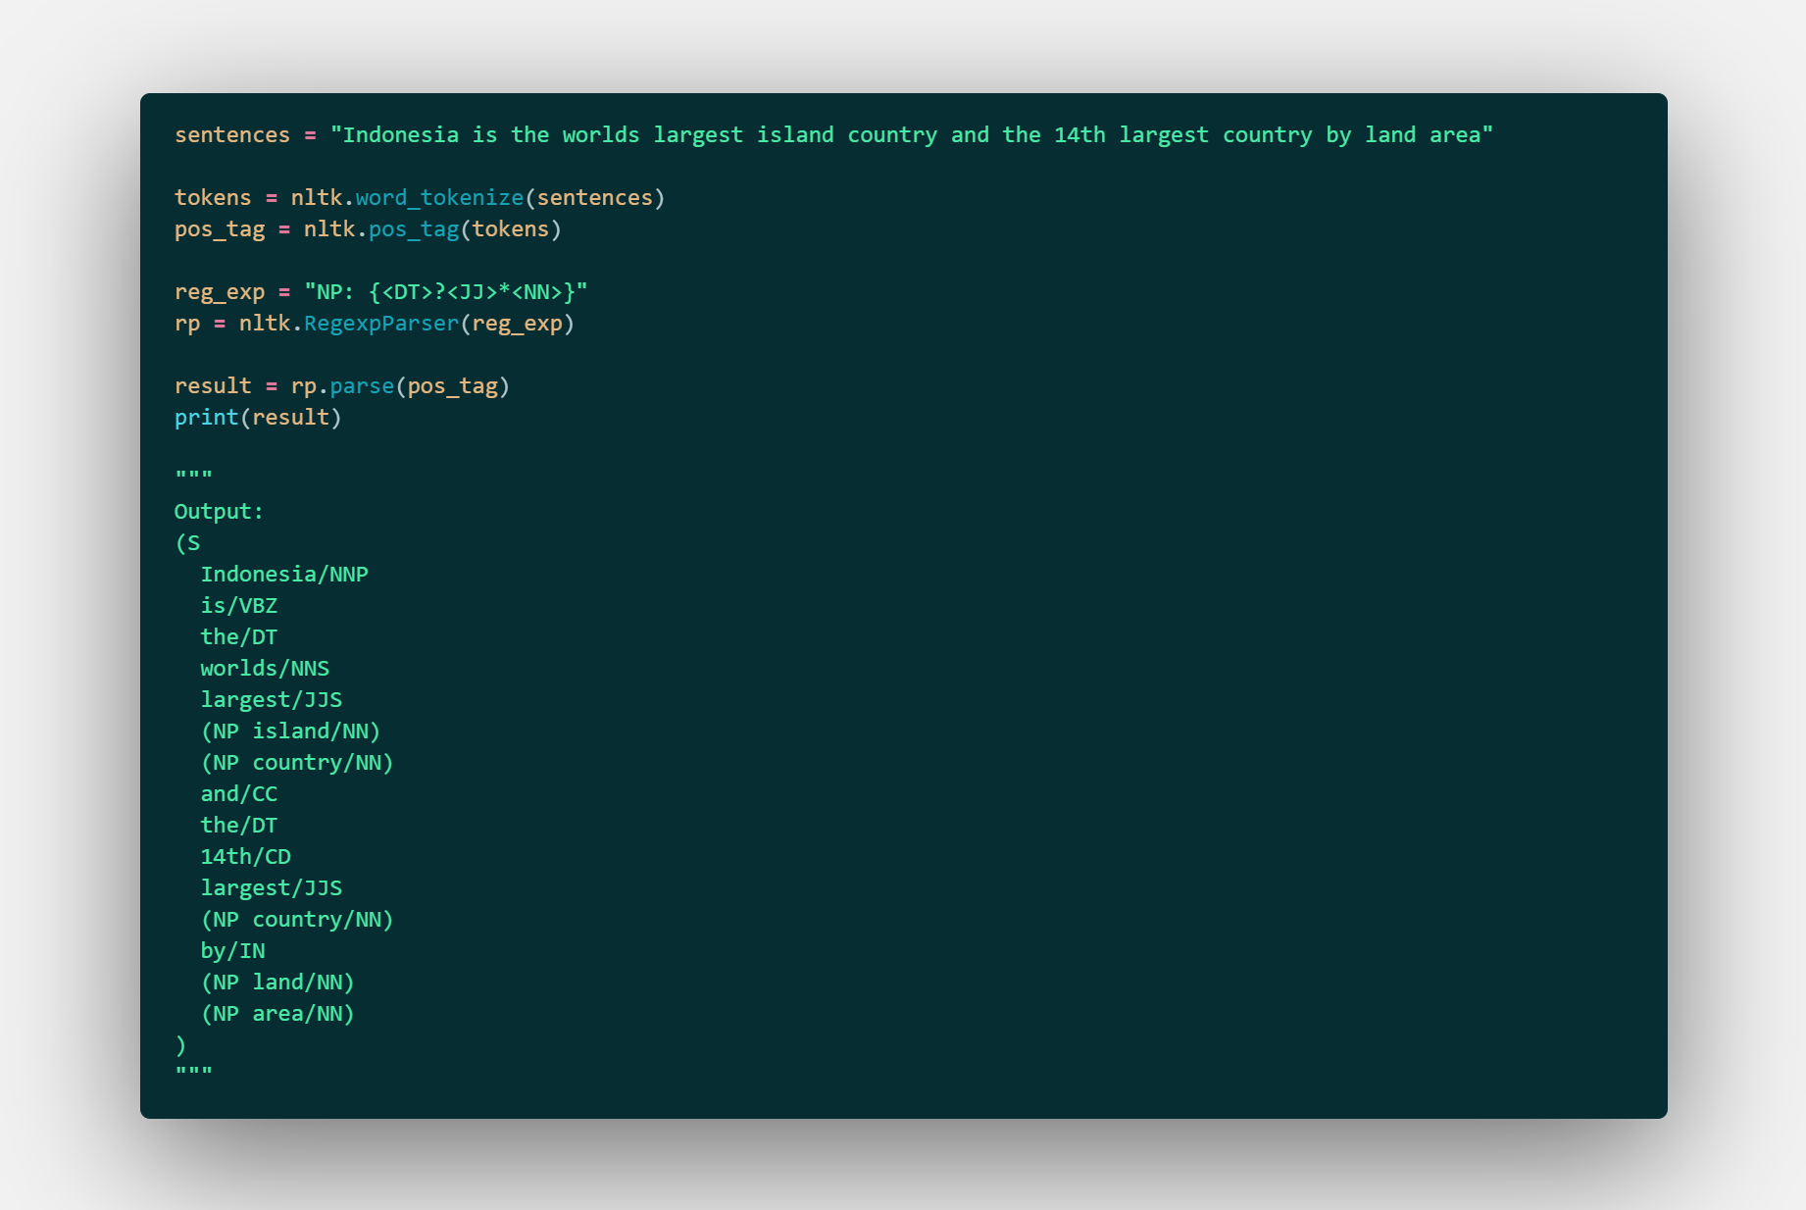

Slide 35
Notes:
Np noun phrase
Frasa nomina
Nomina verba
Kata frasa klausa kalimat

Slide 36
Named Entity Recognition.
Named-entity recognition (NER) aims to find named entities in text and classify them into predefined categories (names of persons, locations, organizations, times, etc.).

Slide 37
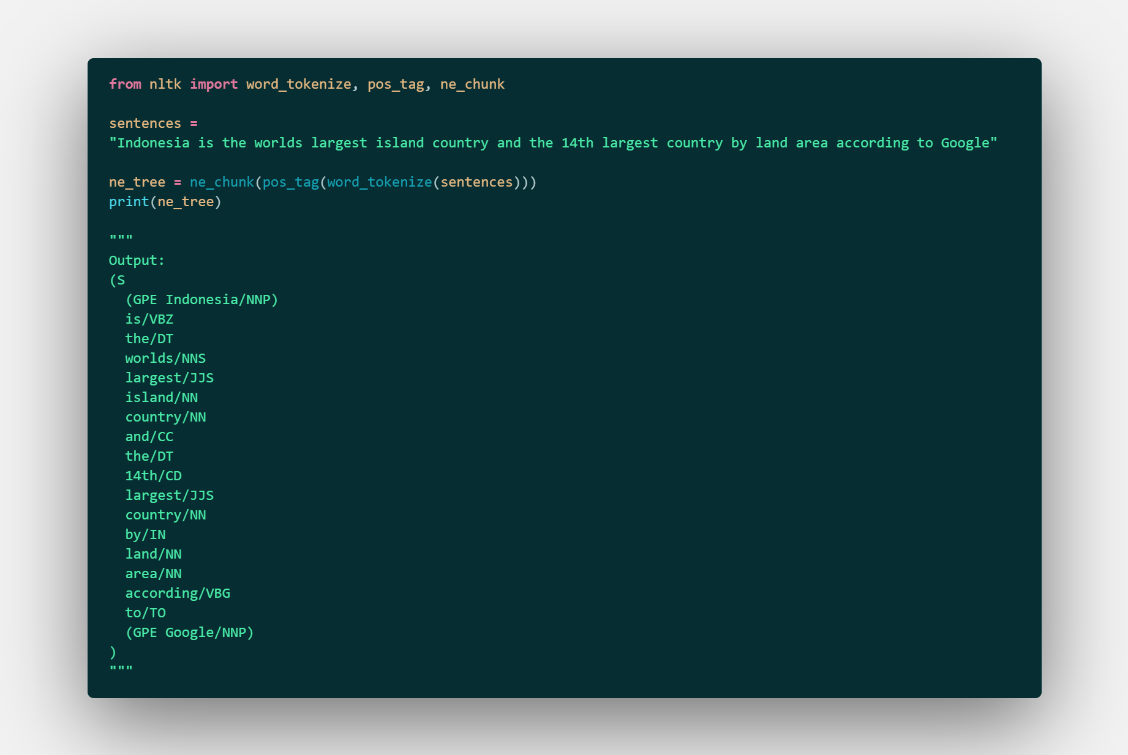

Slide 38
Coreference Resolution.
Pronouns and other referring expressions should be connected to the right individuals. Coreference resolution finds the mentions in a text that refer to the same real-world entity.
For example, in the sentence, “Andrew said he would buy a car” the pronoun “he” refers to the same person, namely to “Andrew”.

Slide 39
Collocation Extraction.
Collocations are word combinations occurring together more often than would be expected by chance.
Collocation examples are “break the rules,” “free time,” “draw a conclusion,” “keep in mind,” “get ready,” and so on.

Slide 40
Relationship Extraction.
Relationship extraction allows obtaining structured information from unstructured sources such as raw text. Strictly stated, it is identifying relations (e.g., acquisition, spouse, employment) among named entities (e.g., people, organizations, locations).
For example, from the sentence “Mark and Emily married yesterday,” we can extract the information that Mark is Emily’s husband.
Notes:
Tidak ada aturan pasti yang membahas setiap tahapan pada text preprocessing. Tentu saja untuk memastikan hasil yang lebih baik dan konsisten semua tahapan harus dilakukan. Untuk memberi gambaran tentang apa yang minimal seharusnya dilakukan, saya telah menguraikan tahapan menjadi harus dilakukan, sebaiknya dilakukan, dan tergantung tugas. Perlu diingat, less is more, anda ingin menjaga pendekatan dengan seindah mungkin. Semakin banyak fitur atau tahapan yang anda tambahkan, semakin banyak pula lapisan yang anda harus kupas.
Harus dilakukan meliputi case folding (dapat tergantung tugas dalam beberapa kasus)
Sebaiknya dilakukan meliputi normalisasi sederhana — misalnya menstandarkan kata yang hampir sama
Tergantung tugas meliputi normalisasi tingkat lanjut — misalnya mengatasi kata yang tidak biasa, stopword removal dan stemming
Jadi, untuk mengatasi tugas apapun minimal anda harus melakukan case folding. Selanjutnya dapat ditambahkan beberapa normalisasi dasar untuk mendapatkan hasil yang lebih konsisten dan secara bertahap menambahkan tahapan yang lainnya sesuai yang anda inginkan.

Slide 41
NLP, Objective.
Machine Translation
Information Extraction
Sentiment Analysis
Information Retrieval
Question Answering
Summarization
Notes:
Punya toko online: jualan desert box dan jualan rice box. Desert box enak, rice box terlalu dikit. How people are feeling about your product. Let's say you have 10000 reviews. You couldn't go to 10000 reviews. Use NLP to figure out positive or negative emotion. People are happy with your desert but not with rice box.

Slide 42
Computer, Sense.
Sentiment Analysis is a process of analysing online pieces of writing to determine the emotional tone they carry.
Notes:
Understanding people’s emotions is essential for businesses since customers are able to express their thoughts and feelings more openly than ever before. By automatically analyzing customer feedback, from survey responses to social media conversations, brands are able to listen attentively to their customers, and tailor products and services to meet their needs.
For example, using sentiment analysis to automatically analyze 4,000+ reviews about your product could help you discover if customers are happy about your pricing plans and customer service.

Slide 43
So Many Feelings.
Sentiment analysis models focus on polarity (positive, negative, neutral) but also on feelings and emotions (angry, happy, sad, etc), and even on intentions (e.g. interested v. not interested).
Fine-grained Sentiment Analysis
Emotion detection
Aspect-based Sentiment Analysis
Multilingual sentiment analysis
Notes:
Here are some of the most popular types of sentiment analysis:
Fine-grained Sentiment Analysis
If polarity precision is important to your business, you might consider expanding your polarity categories to include:
Very positive
Positive
Neutral
Negative
Very negative
This is usually referred to as fine-grained sentiment analysis, and could be used to interpret 5-star ratings in a review, for example:
Very Positive = 5 stars
Very Negative = 1 star
Emotion detection
This type of sentiment analysis aims at detecting emotions, like happiness, frustration, anger, sadness, and so on. Many emotion detection systems use lexicons (i.e. lists of words and the emotions they convey) or complex machine learning algorithms.
One of the downsides of using lexicons is that people express emotions in different ways. Some words that typically express anger, like bad or kill (e.g. your product is so bad or your customer support is killing me) might also express happiness (e.g. this is bad ass or you are killing it).
Aspect-based Sentiment Analysis
Usually, when analyzing sentiments of texts, let’s say product reviews, you’ll want to know which particular aspects or features people are mentioning in a positive, neutral, or negative way. That's where aspect-based sentiment analysis can help, for example in this text: "The battery life of this camera is too short", an aspect-based classifier would be able to determine that the sentence expresses a negative opinion about the feature battery life.
Multilingual sentiment analysis
Multilingual sentiment analysis can be difficult. It involves a lot of preprocessing and resources. Most of these resources are available online (e.g. sentiment lexicons), while others need to be created (e.g. translated corpora or noise detection algorithms), but you’ll need to know how to code to use them.

Slide 44
Why?
Can you imagine browsing the Web, finding relevant texts, reading them, and assessing the tone they carry manually?
Notes:
Sorting Data at Scale Can you imagine manually sorting through thousands of tweets, customer support conversations, or surveys? There’s just too much data to process manually. Sentiment analysis helps businesses process huge amounts of data in an efficient and cost-effective way.
Real-Time Analysis Sentiment analysis can identify critical issues in real-time, for example is a PR crisis on social media escalating? Is an angry customer about to churn? Sentiment analysis models can help you immediately identify these kinds of situations and gauge brand sentiment, so you can take action right away.
Consistent criteria It’s estimated that people only agree around 60-65% of the time when determining the sentiment of a particular text. Tagging text by sentiment is highly subjective, influenced by personal experiences, thoughts, and beliefs. By using a centralized sentiment analysis system, companies can apply the same criteria to all of their data, helping them improve accuracy and gain better insights.

Slide 45
What for?
Brand reputation management
Customer feedback
Crisis prevention
Politics
Notes:
Brand reputation management
The Internet is where consumers talk about brands, products, services, share their experiences and recommendations. Social media, review sites, blogs and discussion forums are boiling with opinions which, if collected and analyzed, are a rich source of business information.
When it comes to brand reputation management, sentiment analysis can be used for brand reputation management to analyze web and social media opinions about a product, a service, a marketing campaign or a brand.
Online sentiment analysis helps to gauge brand reputation and its perception by consumers.
Customer feedback
Companies do sentiment analysis to analyze customers’ opinions.
These days, consumers use social media to share both their positive and negative experiences with brands. Sentiment analysis tools can identify mentions conveying super positive pieces of content showing strengths, as well as negative mentions, bad reviews and problems users write about online.
UBER
Some time ago UBER used social media monitoring and sentiment analysis tool to discover if users like the new version of their app.
It’s a pretty good case study that illustrates the use of sentiment analysis.
“At Uber, we use social listening on a daily basis, which allows us to understand how our users feel about the changes we’re implementing. As soon as we introduce a modification, we know which parts of it are greeted with enthusiasm, and which need more work. We’re happy that the new app was received so well because we’ve put a lot of work into it”, says Krzysiek Radoszewski, Marketing Lead for central and eastern Europe at Uber.
Crisis prevention
Some sentiment analysis tools, like Brand24, collect and analyze pieces of writing containing predefined keywords in real time. On seeing a negative mention, a company can quickly react and nip the problem in the bud before it escalates into a social media crisis.
United Airlines
Last year, United Airlines experienced an image crisis. Using a social media monitoring tool, we analyzed the sentiment of #UnitedAirlines hashtag. I wonder if they used a sentiment analysis tool at that time.
Politics
Sentiment analysis is also used in politics. In 2012, the Obama administration used sentiment analysis tools to analyze the reception of policy announcement during 2012 presidential election.
During the last presidential election in the US, some organizations analyzed, for example how many negative mentions about particular candidates appeared in the media and news reports.
There have been at least a few academic papers examining sentiment analysis in relation to politics.
Prediction of Indian election on the basis of Twitter sentiment analysis
Political Data Science: Analyzing Trump, Clinton and Sanders Tweets and Sentiment
Analysis of political sentiment in presidential elections in Egypt using Twitter data

Slide 46
Computer, Observe.
Rule-based systems that perform sentiment analysis based on a set of manually crafted rules.
Automatic systems that rely on machine learning techniques to learn from data.
Hybrid systems that combine both rule-based and automatic approaches.
Notes:
Rule-based Approaches
Usually, a rule-based system uses a set of human-crafted rules to help identify subjectivity, polarity, or the subject of an opinion.
These rules may include various techniques developed in computational linguistics, such as:
Stemming, tokenization, part-of-speech tagging and parsing.
Lexicons (i.e. lists of words and expressions).
Here’s a basic example of how a rule-based system works:
Defines two lists of polarized words (e.g. negative words such as bad, worst, ugly, etc and positive words such as good, best, beautiful, etc).
Counts the number of positive and negative words that appear in a given text.
If the number of positive word appearances is greater than the number of negative word appearances, the system returns a positive sentiment, and vice versa. If the numbers are even, the system will return a neutral sentiment.
Rule-based systems are very naive since they don't take into account how words are combined in a sequence. Of course, more advanced processing techniques can be used, and new rules added to support new expressions and vocabulary. However, adding new rules may affect previous results, and the whole system can get very complex. Since rule-based systems often require fine-tuning and maintenance, they’ll also need regular investments.
Automatic Approaches
Automatic methods, contrary to rule-based systems, don't rely on manually crafted rules, but on machine learning techniques. A sentiment analysis task is usually modeled as a classification problem, whereby a classifier is fed a text and returns a category, e.g. positive, negative, or neutral.
The Training and Prediction Processes
In the training process (a), our model learns to associate a particular input (i.e. a text) to the corresponding output (tag) based on the test samples used for training. The feature extractor transfers the text input into a feature vector. Pairs of feature vectors and tags (e.g. positive, negative, or neutral) are fed into the machine learning algorithm to generate a model.
In the prediction process (b), the feature extractor is used to transform unseen text inputs into feature vectors. These feature vectors are then fed into the model, which generates predicted tags (again, positive, negative, or neutral).
Feature Extraction from Text
The first step in a machine learning text classifier is to transform the text extraction or text vectorization, and the classical approach has been bag-of-words or bag-of-ngrams with their frequency.
More recently, new feature extraction techniques have been applied based on word embeddings (also known as word vectors). This kind of representations makes it possible for words with similar meaning to have a similar representation, which can improve the performance of classifiers.
Classification Algorithms
The classification step usually involves a statistical model like Naïve Bayes, Logistic Regression, Support Vector Machines, or Neural Networks:
Naïve Bayes: a family of probabilistic algorithms that uses Bayes’s Theorem to predict the category of a text.
Linear Regression: a very well-known algorithm in statistics used to predict some value (Y) given a set of features (X).
Support Vector Machines: a non-probabilistic model which uses a representation of text examples as points in a multidimensional space. Examples of different categories (sentiments) are mapped to distinct regions within that space. Then, new texts are assigned a category based on similarities with existing texts and the regions they’re mapped to.
Deep Learning: a diverse set of algorithms that attempt to mimic the human brain, by employing artificial neural networks to process data.
Hybrid Approaches
Hybrid systems combine the desirable elements of rule-based and automatic techniques into one system. One huge benefit of these systems is that results are often more accurate.

Slide 47
Create, Feelings.
Access the materials: bit.ly/H8_SCL
Access the source code: github.com/ardhiraka/H8_SCL2020
Notes:
Alt+Tab

Slide 48

Your Feedback Matters!
https://techatshopee.formstack.com/forms/shopeecodeleague_workshopfeedbackform

